Slide 1
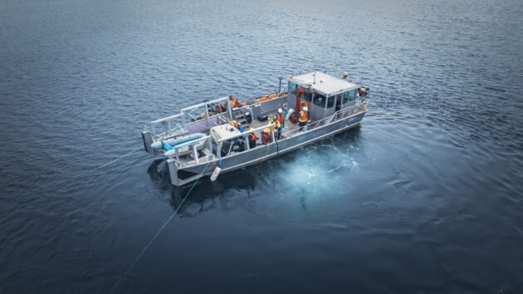
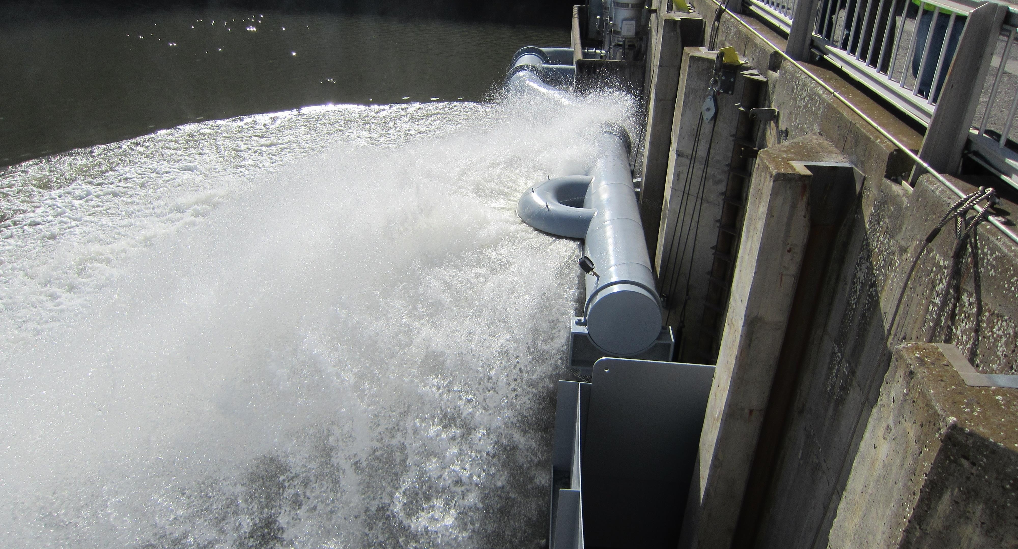
LOMO Ladder cooling
April 2, 2026
Project Update
CFD Modeling

Slide 2
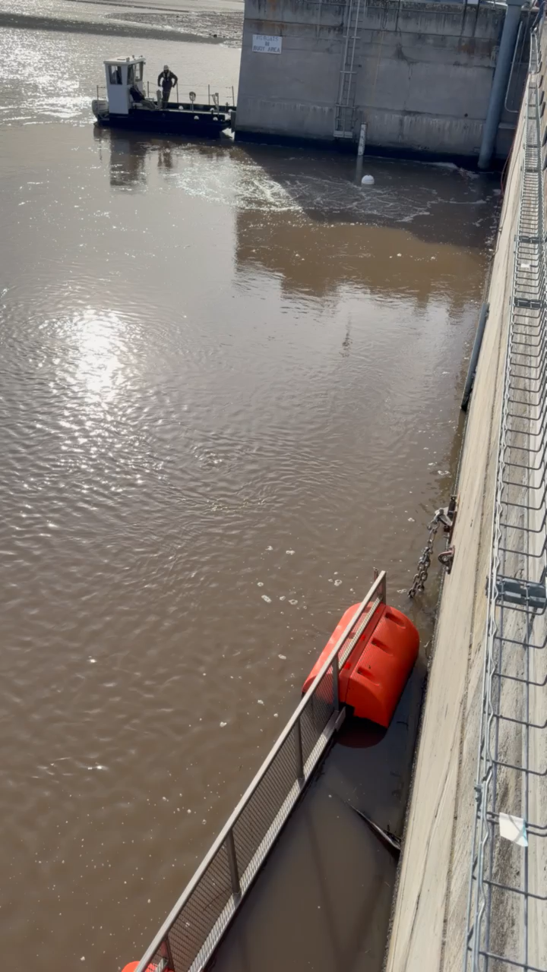
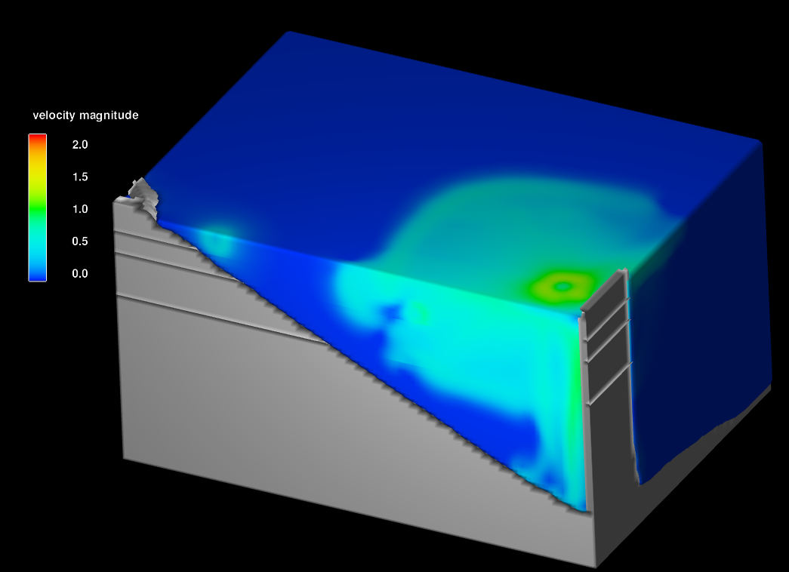
Prototype & model – no Thermocline
CFD model of bubbler prototype. Simulation not completed but shows similar plume size and velocities along dam face at 5 minutes of simulation time.
March 23rd Prototype test 30 cfm at ~85’.
Approx 0.25 fps
at ladder exit after 10 minutes of runtime.

Slide 3
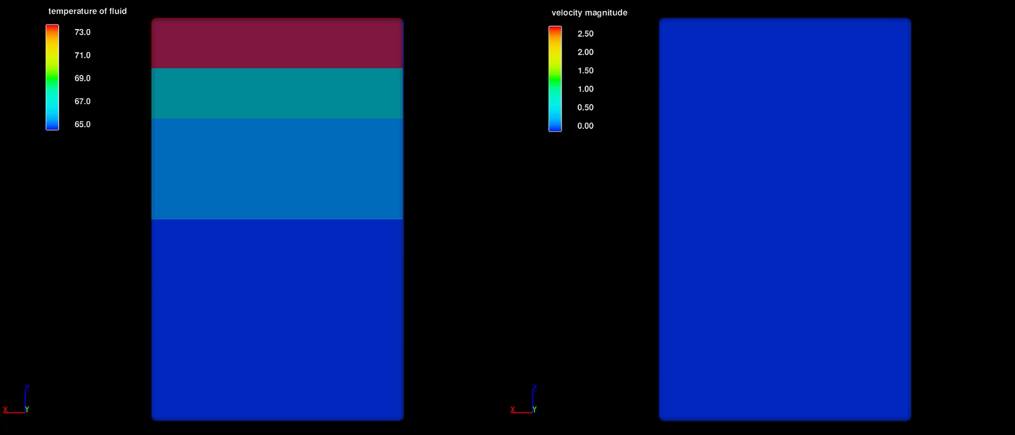
Bubbler plume (4.5-minute real time)

Slide 4
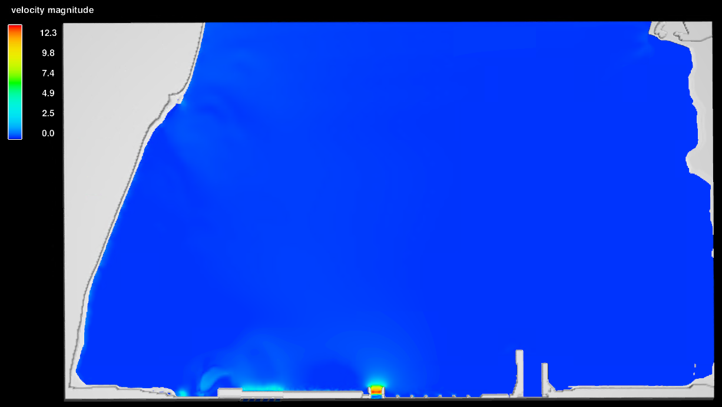
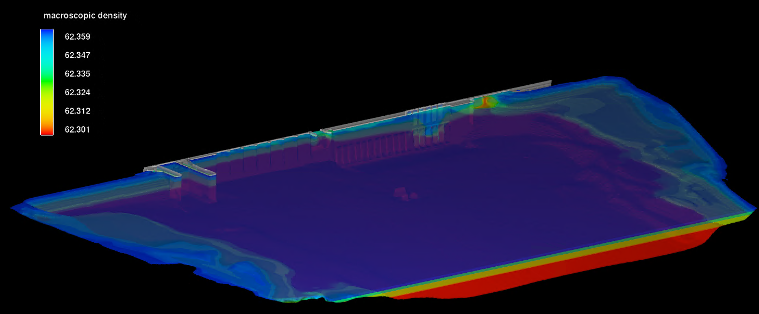
Forebay Model
Modeling Lomo forebay conditions with stratified temperature layers with typical July – August conditions (~35kcfs)
Snapshot taken from early in simulation, flows have not fully developed yet, model shows idea.
  Will use these results as boundary conditions for the final bubbler model.
Forebay Velocities
Forebay Temperatures

